Slide 1
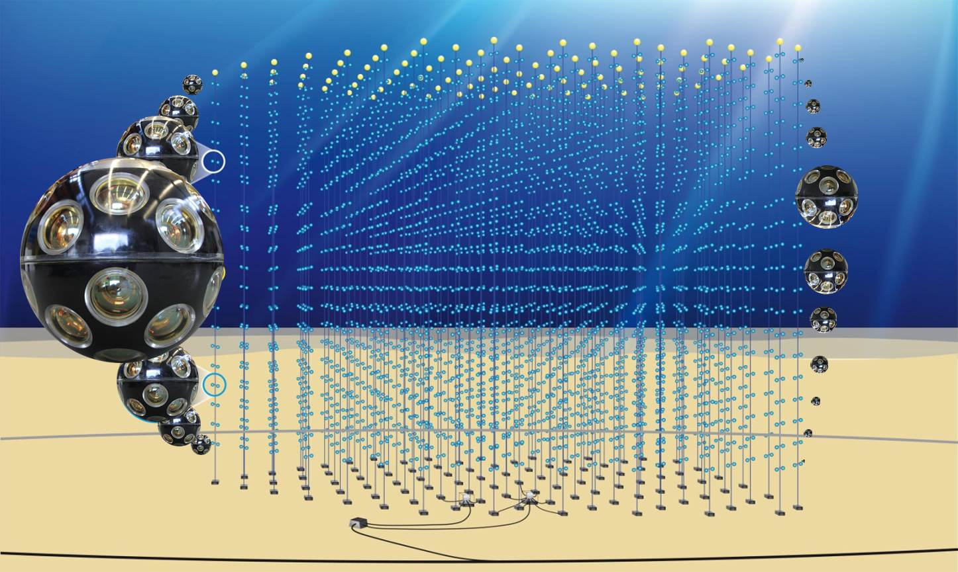


Synergies with Neutrino telescopes
Maurizio Spurio
Università di Bologna and INFN

Slide 2
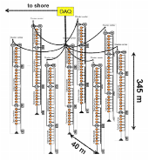
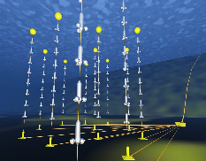
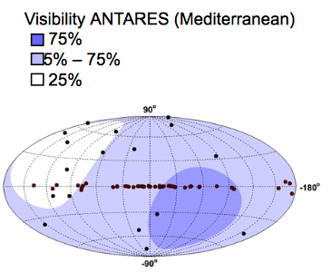

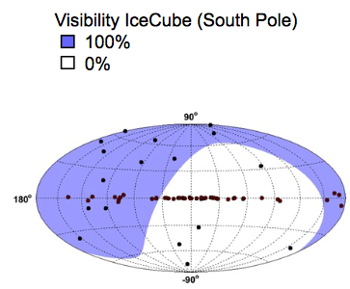
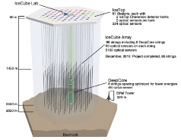
Neutrino telescopes. Where …
ANTARES
KM3NeT/ORCA
KM3NeT/ARCA
GVD
IceCube

Slide 3
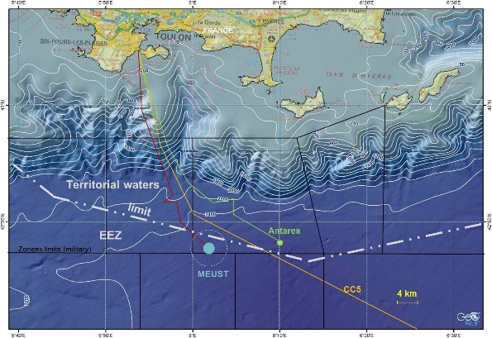
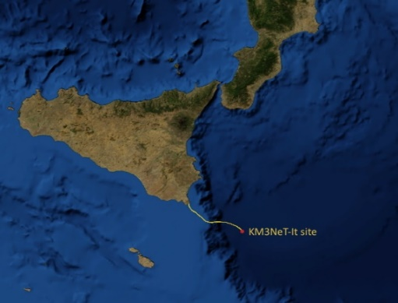
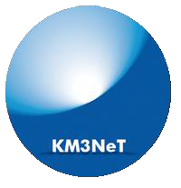
The ν telescope in the Mediterranean sea
KM3NeT is the ν research infrastructure in the MedSea
  ARCA (off shore Capo Passero, It @ 3500 m depth) discover and observe high neutrino sources in the Universe
  ORCA (off shore Toulon, Fr @2500 m depth) determine ν mass hierarchy
Same collaboration, same technology, two installation sites
2475m
ORCA
3400m
ARCA

Slide 4
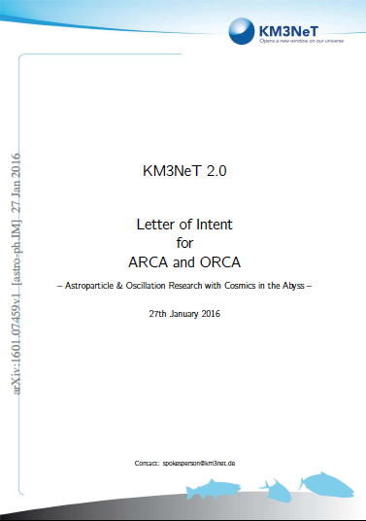

The KM3NeT phased approach
LoI: J. Phys. G, 43 (2016) 084001
H2020: funds to prepare the ERIC
The process to build the KM3NeT ERIC is in progress
PHASE | BLOCKS | PRIMARY DELIVERABLES | FUNDS
1 | 0.2 | Proof of feasibility and first science 24 ARCA + 6 ORCA strings | Fully funded
2 | 2+1 | All flavor ν physics and astronomy 2 x 115 ARCA strings 1 x 115 ORCA strings | In progress (presently 1/3 available)
3 | 6 | Astronomy including Galactic sources | Next step

Slide 5
Roadmap and timelines for ν-telescopes
ANTARES: no superposition with THESEUS (end: ∼2021)
KM3NeT/ARCA: Phase 1 with >24 detector lines in construction. The detector is modular (it can work also during the construction phase).
Funding in progress for KM3NeT/ARCA Phase 2 (2 blocks of 115 strings, more than 3 times the present IceCube sensitivity in the neutrino energy range 0.1 TeV- 1 PeV). Operation (with at least 1 block) in ∼2025 for more than 10 year. Golden channel (angular resolution) for neutrino telescopes are upgoing events: IceCube has the best sensitivity for the Northern Sky, while KM3NeT for the Southern one. Galactic sources can be studied with unprecedented sensitivity.
IceCube will continue data taking at the South Pole; a further increase in the number of string possible, with increase of the sensitivity toward high energy (>100 TeV) (until: ?)
GVD (a third neutrino detector in the Lake Baikal, Russia) in advanced construction. Performances (energy range measurement, angular resolution) difficult to assess now.

Slide 6

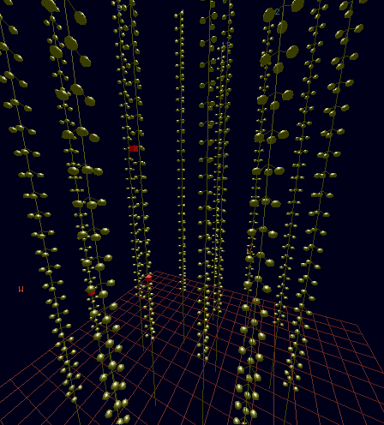
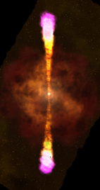

Shower- and track-like events
Cherenkov photons emitted by charged particles are correlated (space/time)
Event Reconstruction based on time-space correlations of fired PMTs (hits) in the PMTs
Tracks (CC ν_{μ}): Long pattern
Cascades (CC ν_{e}+ NC): Short pattern
Neutrino Direction reconstructed from time-space correlation between hits produced by Cherenkov photons
Neutrino Energy reconstructed from signal amplitudes of the detected hits

Slide 7
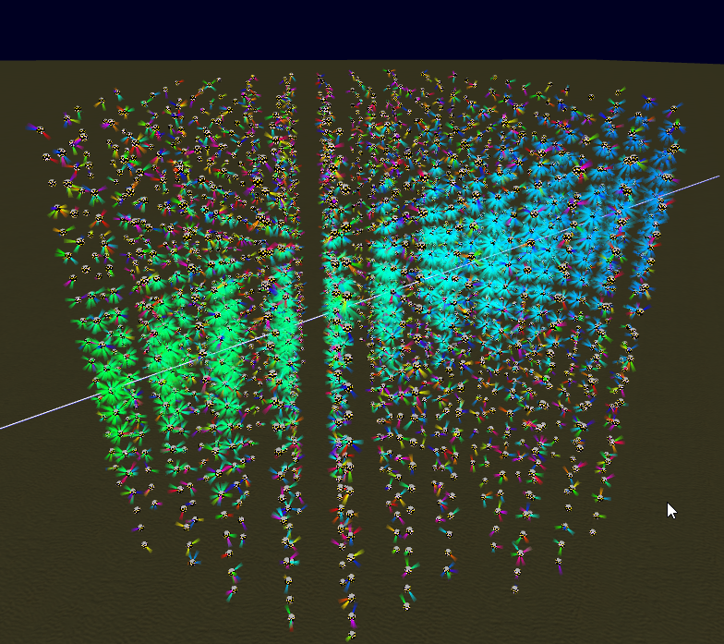
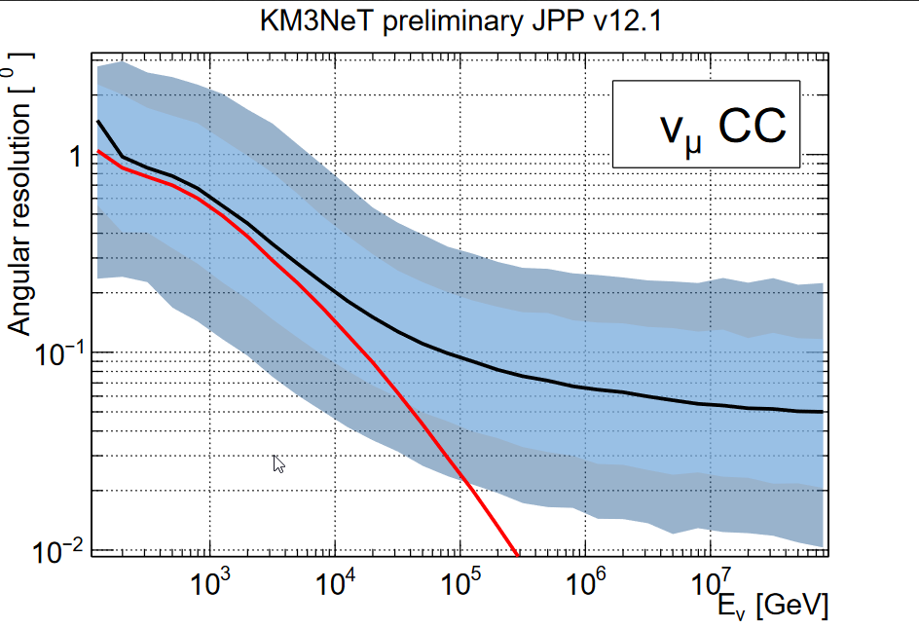
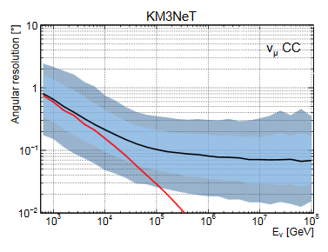
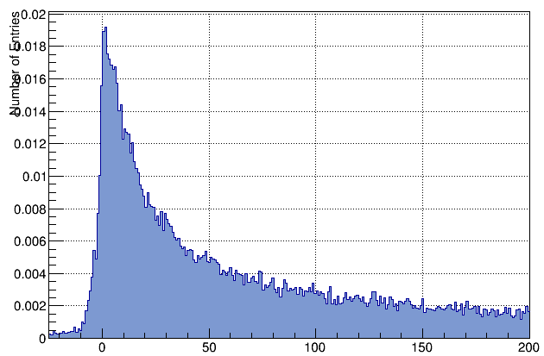
KM3NeT/ARCA : tracks reconstruction
Excellent resolution due to
good water properties
Physics limited < 10 TeV
0.1 degree at 100 TeV
0.05 degree at 100 PeV
Angular resolution (median)
1 sigma
90%
ν-μ angle
ν-μ scattering
angle
Reconstruction uses time
Profile vs distance and PMT orientation

Slide 8
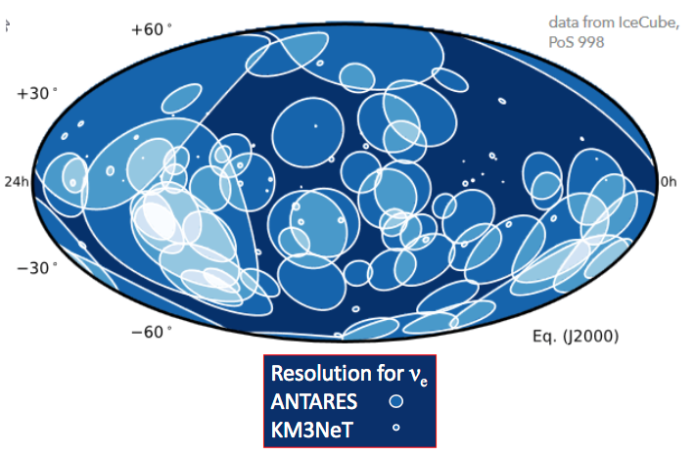
KM3NeT/ARCA : Showers reconstruction

Slide 9
Scientific goal of Neutrino Telescopes (NuTel)
Task/deliverables needed to quantify and describe the THESEUS synergy:
NuTel are discovery-driven: cosmic ν’s exist, but we do not know the origin and sources
Models foresee enhanced ν emission during flaring activities and during hardness transition states in X-ray sources. Primary targets can be Galactic X-ray binaries composed of a compact object (neutron star or stellar mass black hole candidate) and a companion non-degenerate star; extragalactic flaring blazars; transient flares (GRBs)... → prompt alert/online
NuTel have almost 100% duty cycle and can observe 2π sr with angular resolution down to 0.1º (and 2π sr with angular resolution of ∼ few degrees).
NuTel are well suited for the study of transient events. The main goal is to observe object for which hadron acceleration mechanisms take place.
NuTel can answer to an external alert in few seconds (if a candidate exists within 2-3x angular resolution); it can also provide fast dissemination of interesting events (high-energy, doublets,) within few seconds.

Slide 10
Online Alert Sending and Reporting
Alert sending policy with typical alert rate of few per month
During the commissioning phase, all alerts will stay private. Only observing teams upon MoU will have access.
After the commissioning phase, notable events will trigger alerts that will be distributed publicly to the astro community
Channel: via the GCN network. Message: VOEvent (XML file). VO (Virtual Observatory) Event is a standardized format to report observations of astronomical events

Slide 11

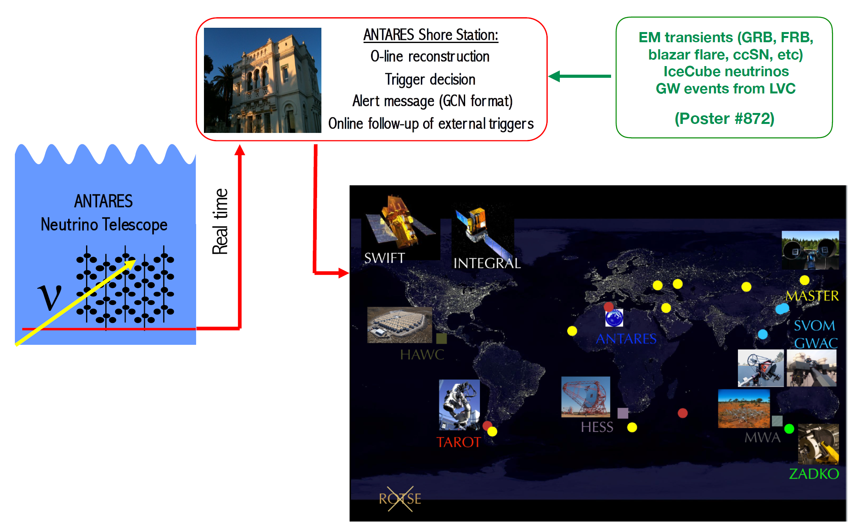
ANTARES Online framework
NIMA 656 (2011) 11
Astrop. Phys. 35 (2012) 530

Slide 12
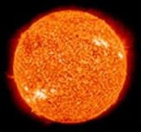
ANTARES neutrino alert selection
Triggers (upgoing tracks):
Doublet of neutrinos: ~0.04 evt / yr.
Single neutrino with direction close to local galaxies (1 TeV): ~10 evt / yr.
Single HE neutrinos (7 TeV): ~ 15 evt/yr
  VHE neutrinos (30 TeV): ~ 3-4 evt/yr.
ANTARES ~0.4º
KM3NeT ~0.1º
PSF:
N. alarms
Alert delay:
Alert message sent via GCN using GCN socket/VO Event (XML file)
Average delay: ~6-7 s (filtering, online reco, neutrino selection, alert message)
Delay time (s)

Slide 13
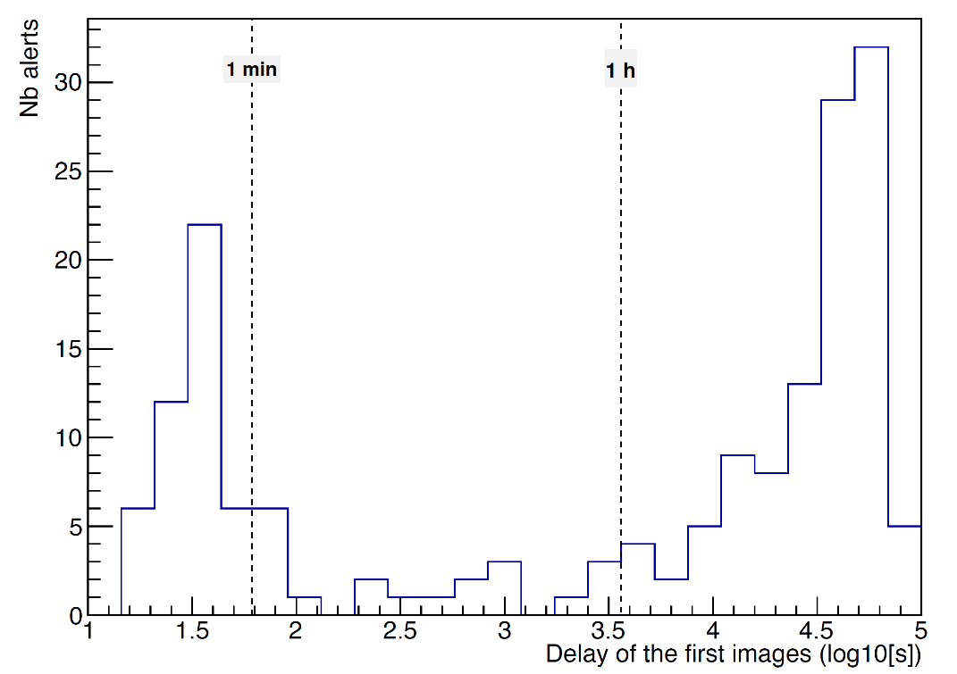
ANTARES neutrino alert selection: follow-ups
Status ANTARES alerts
(Oct 2009 - July 2019):
• 311 robotic optical telescopes
• 18/25 followed by Swift-XRT
• 4 followed by Integral
• 4 followed by MWA
• 2 followed by H.E.S.S.
JCAP02(2016)062
Follow-up delay (optical):
Δt between 1st image/trigger:
  55 alerts < 1 min
  208 alerts < 1 day
(wait for the alert visibility, stop previous acquisition, point the telescope, start the acquisition)

Slide 14
X-ray follow-up
X-ray:
18/25 (72%) alerts followed by Swift-XRT from 06/2013-07/2019 average delay ~6 h (best 1.1h)
no transient candidate
Constrains on origin of ν’s
Interpretation of the UL in the case of GRB afterglow
JCAP02(2016)062
Grey lines: 689 X-ray afterglow fluxes (0.3-10 keV) detected by the Swift-XRT vs time. Red triangles: upper limits on GRB fluxes for the neutrino alerts.
Each Swift-XRT observation of an ANTARES trigger consists of 4 tiles (black circles), which covers an area of radius of ∼ 0.4º. With such a mapping, 72% of the bi-directional uncertainty of an ANTARES alert is covered.

Slide 15

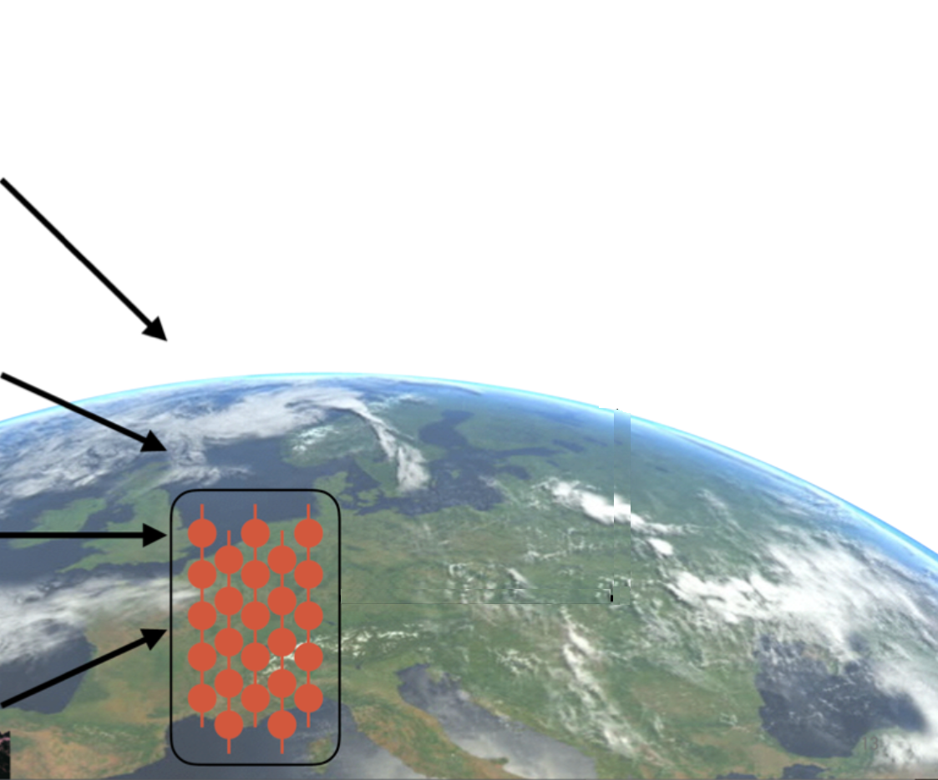
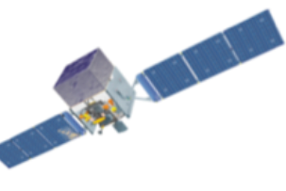
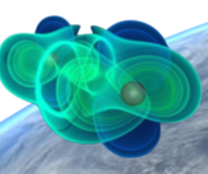
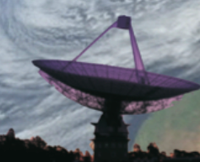
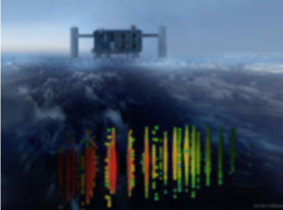
KM3NeT online alert system
Online, calibrated, alert within 5 s, median angular resolution 0.1-0.2º.
Tasks running in parallel
Online Calibration
(charge, time, positioning)
Track reco (∼1-3 s)
Time and charge of all PMTs over threshold to the computer farm (100 km away)
1
Alert sending
(∼ 1 s)
Shower reco (2-3 s)
Data filter
(∼2-3 s)
SN identification
2
Online searches
Data monitoring
“L0” buffering

Slide 16
Relevant Papers
We do not have papers on synergies with THESEUS.
The present generation of neutrino telescope in the Mediterranean Sea (ANTARES) has studied possible correlation between X-ray satellites
  Galactic X-ray binaries in: JCAP04(2017)019
  flaring blazars in: Astroparticle Physics 36 (2012) 204–210 and JCAP 1512 (2015) 12, 014
  Methods for X-ray early follow-up of neutrino alerts are described in JCAP02(2016)062 .
The generalities of the ANTARES telescope neutrino alert system (that is the prototype of the KM3NeT one) is in
  Astropart.Phys. 35 (2012) 530-536

Slide 17





Summary and Perspectives
ν astronomy is on its way to increased sensitivity and full sky coverage
ν are an indispensable ingredient of multi-messenger astronomy
ν telescopes: opportunities for precision measurements in ν physics
ANTARES: more than 10 years of continuous data taking!
KM3NeT: long term (>10 y) survey with 2π sr FoV with angular resolution ∼0.2º and ∼100% duty cycle
ANTARES and KM3NeT active multi-messenger program:
  - Neutrino alerts distribution, participation to GCN and AMON
  - External alerts reception, prompt analysis
  - Offline multi-messenger analysis.
  - Combined analyses with IceCube.
Best practice and multi-messenger collaborations ported from ANTARES to KM3NeT!

