Slide 1
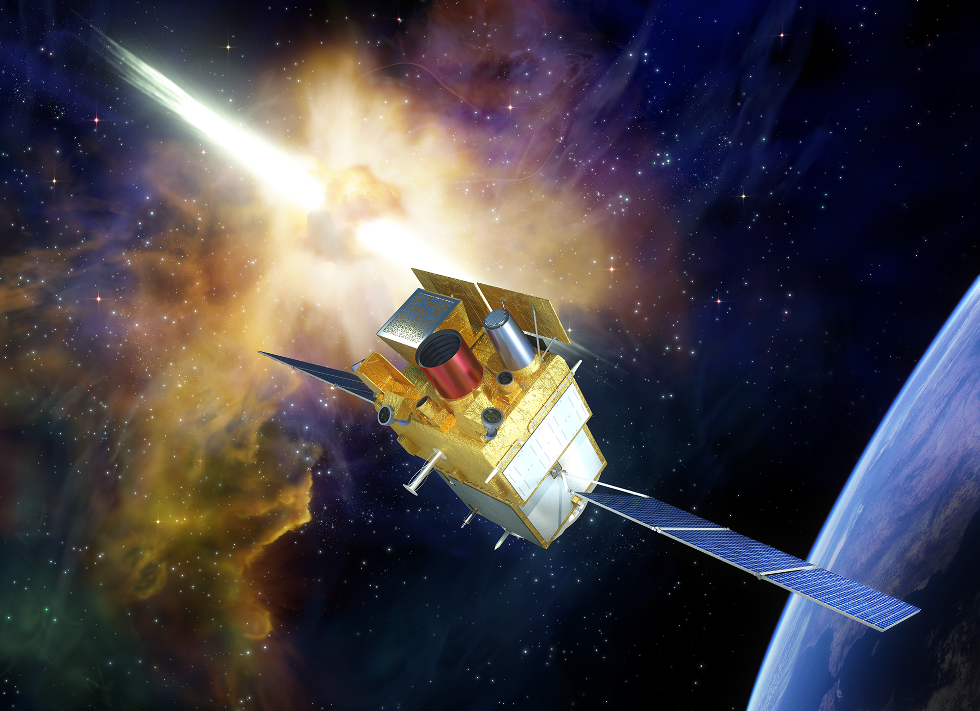

the Svom mission
B. Cordier (CEA) & S. Basa (LAM)

Slide 2
The science of svom
Three main scientific programs:
Core Program: GRBs
General Program: AGN, TDE, galactic sources (CVs, XRBs, pulsars, magnetars), TGF, CXB, etc
Targets of Opportunity (1/day): search for counterparts to multi-wavelength (SKA, LSST, CTA, HAWC, etc) or multi-messenger (GWs, neutrinos) triggers
After three years:
Higher ToO fraction (up to 5/day)
More GP time outside the B1 law (from 10% to 50% of GP allocation)

Slide 3
SVOM “Space-based multi-band astronomical Variable Objects Monitor”
a Sino-French mission dedicated to GRBs and transient sources
to be launched end 2021, duration 3+2 years

Slide 4
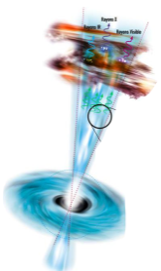
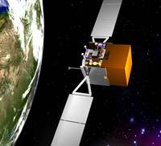
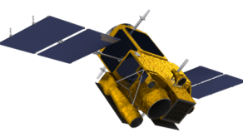
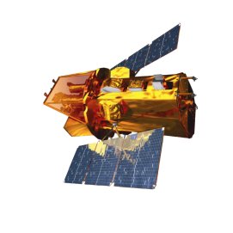
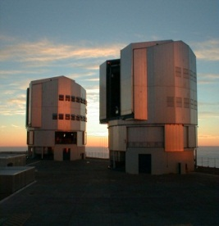
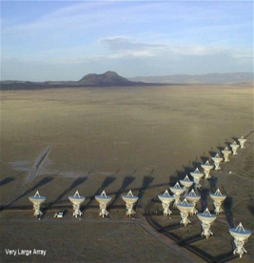
GRB Observation scenario
GRB
waiting
Auto slew
T0 GRB trigger
On board
VHF
T0+5min
VT,MXt observation
On Ground
F SC
Other SC mission center
T0+30s
Inside SVOM
Outside SVOM
C SC
T0+1min
GCN
GRB coordination distribute
Large telescope

Slide 5
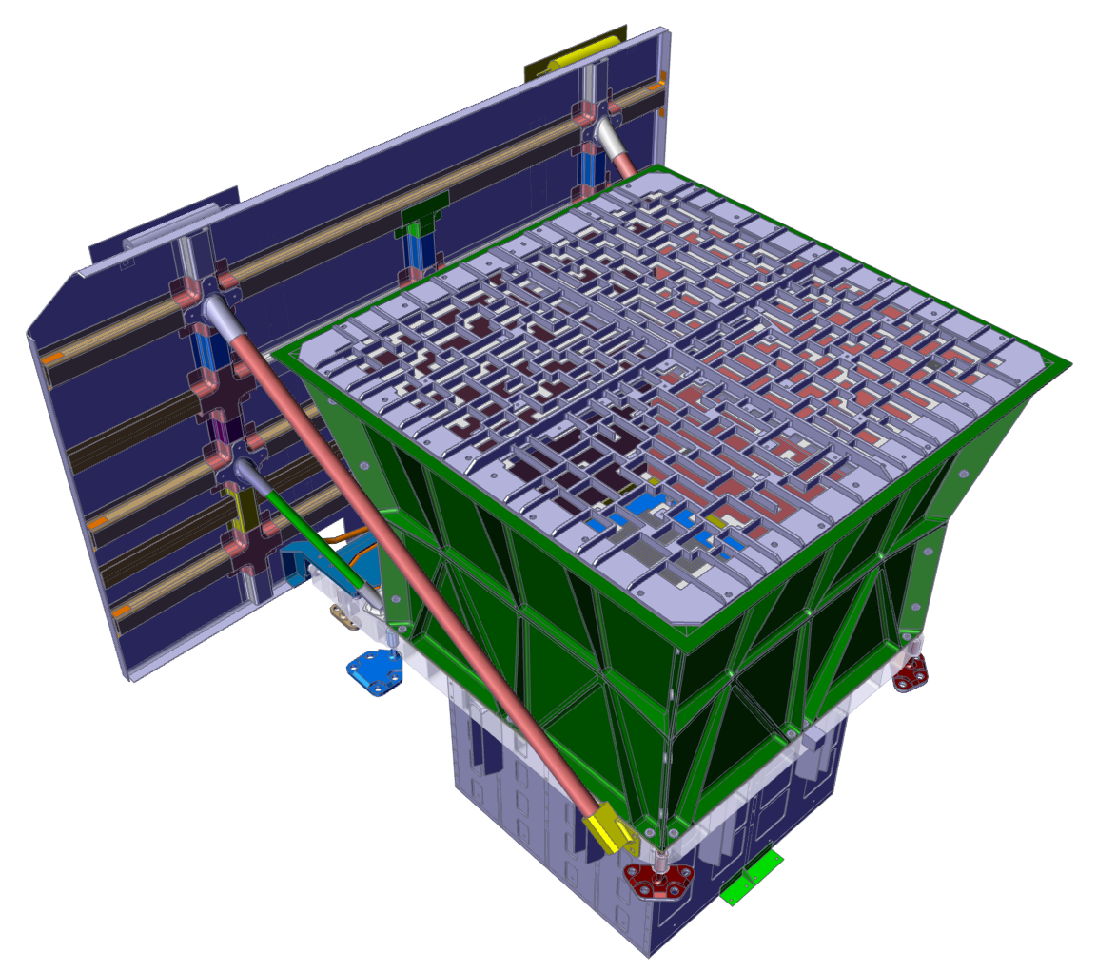
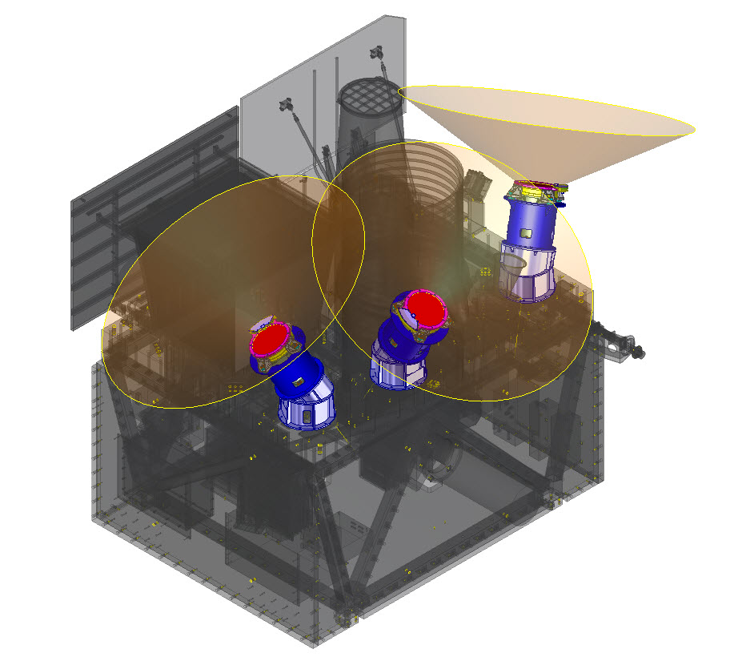
instruments (with large field of view)
The space segment –the payload
ECLAIRs (CNES, IRAP, CEA, APC)
40% open fraction
Detection plane: 1024 cm²
6400 CdTe pixels (4x4x1 mm³)
FoV: 2 sr (zero sensitivity)
Energy range: 4 - 150 keV
Localization accuracy <12 arcmin for 90% of sources at detection limit
Onboard trigger and localization: ~65 GRBs/year
Well adapted for the detection of lGRB with low EPEAK
GRM Gamma-Ray Monitor (IHEP)
3 Gamma-Ray Detectors (GRDs)
NaI(Tl) (16 cm Ø, 1.5 cm thick)
Plastic scintillator (6 mm) to monitor particle flux and reject particle events
FOV: 5,6 sr 3 GRDs, 1,0 intersection of 3 GRDs
Energy range : 30-5000 keV
Aeff = 190 cm² at peak
Rough localization accuracy
Expected rate: ~90 GRBs / year
Will provide EPEAK measurements for most ECLAIRs GRBs
Will detect short GRBs in & out of the ECLAIRs FOV

Slide 6
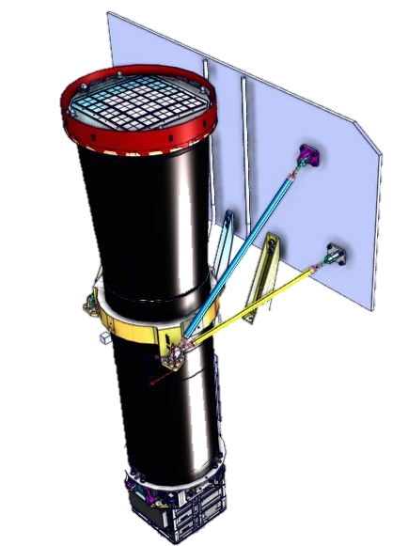
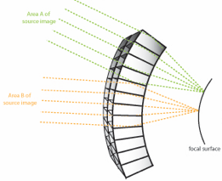
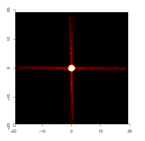
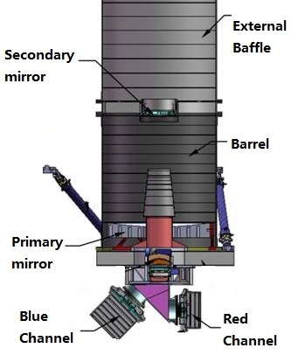
instruments (with narrow field of view)
THE SPACE SEGMENT – THE PAYLOAD
MXT Micro-channel X-ray Telescope (CNES, CEA, UL, MPE)
Micro-pores optics (Photonis) with 40 µm square pores in a “Lobster Eye” conf. (UL design)
pnCCD (MPE) based camera (CEA)
FoV : 64x64 arcmin²
Focal length: 1 m
Energy range : 0.2 – 10 keV
Aeff = 27 cm² @ 1 keV (central spot)
Energy resolution: ~80 eV @ 1.5 keV
Localization accuracy <13 arcsec within 5 min from trigger for 50% of GRBs (statistical error only)
Implements innovative focussing X-ray optics based on « Lobster-Eye » design
Will reduce the ECLAIRs error box
Will be able to promptly observe the X-ray afterglow
VT Visible Telescope (XIOMP, NAOC)
Ritchey-Chretien telescope, 40 cm Ø, f=9
FoV: 26x26 arcmin², covering ECLAIRs error box in most cases
2 channels: blue (400-650 nm) and red (650-1000 nm), 2k * 2k CCD detector each
Sensitivity MV=23 in 300 s
Will detect ~80% of ECLAIRs GRBs
Localization accuracy <1 arcsec
Able to detect high-redshift GRBs up to z~6.5 (sensitivity cutoff around 950 nm)
Can quickly provide redshift indicators due to the presence of two channels

Slide 7

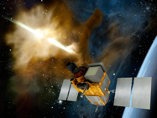
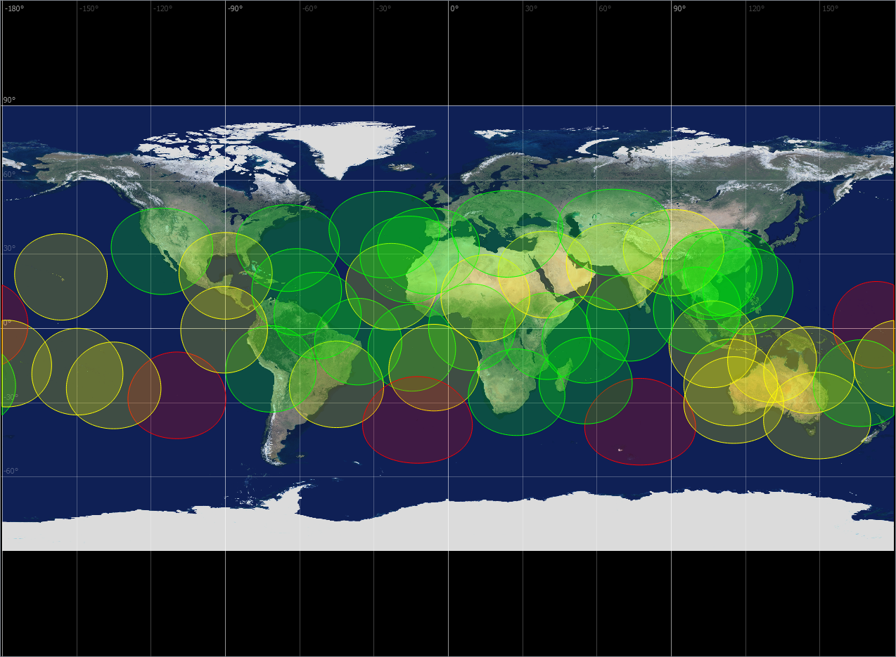

svom alert system
The VHF NETWORK
Alerts are transmitted to a network of ~40 VHF receivers on Earth
Goal: 65% of the alerts received within 30 s at the French Science Center

Slide 8
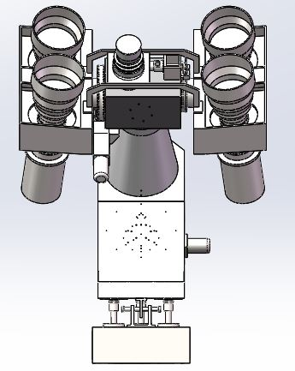
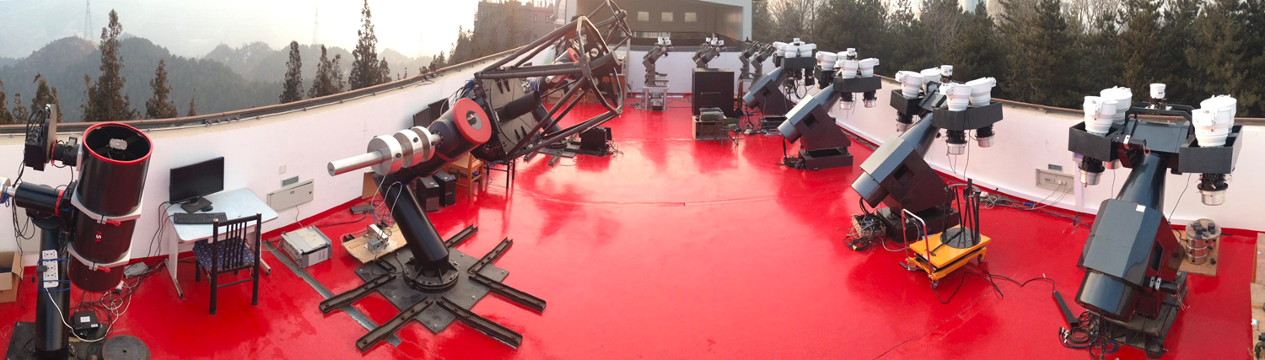
Ground Wide Field CamEras (GWACs)
The Ground segment
Cameras： 40
Diameter： 180mm
Focal Length： 220mm
Wavelength： 500－800nm
Total FoV： ~6000Sq.deg
Limiting Mag： 16.0V（5σ，10sec）
Self Trigger: ~13*5sec

Slide 9


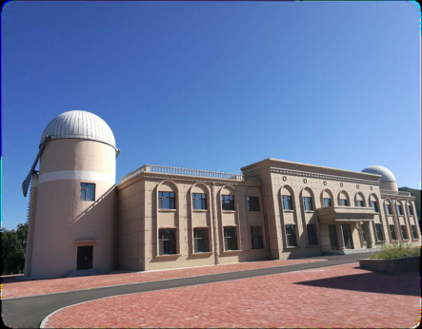
The Ground Follow-up telescopes (GFTs)
The Ground Segment
GFTs permit the fast identification and measure of early optical/NIR afterglows (light-curve, SED) using the ECLAIRs positions, while the spacecraft is slewing to the source.
C-GFT is located at Changchun observatory (Jilin province)
COLIBRI (F-GFT) is located at San Pedro de Martir (Mexico)
Diameter : 120cm
FOV : 90 x 90 arcmin
400 – 900nm
Diameter : 130 cm
FOV : 26 x 26 arcmin
400 – 1700 nm

Slide 10
Tests in china, january 2020
From a dream to the reality…

Slide 11

SVOM Status
Launch
16/12/21
2015
2016
2017
2018
2019
Today
Start
01/09/14
2020
2021
2022
Phase B
01/09/14 - 01/01/17
Phase C
01/01/17 - 20/10/19
Phase D
01/01/20 - 17/12/21
E1
End
09/03/22
Delivery of EQM
02/19
Delivery of STM
06/19
Delivery of PFM
12/20
RRV
09/03/22
Initial launch date: December 2021.
Difficult to foresee the consequences of the current situation (6 to 10 months delay, TBC), but we can reasonably expect a commissioning in 2022:
Duration of 3 years (nominal) + 2 years (extension).
No guarantee that SVOM will be contemporary with Theseus.
But a very useful pathfinder in view of the ESA selection process:
Validation of the VHF network.
Validation of the lobster eyes optics (MXT).
Validation of the ALFA IR sensor (COLIBRI).

