Slide 1
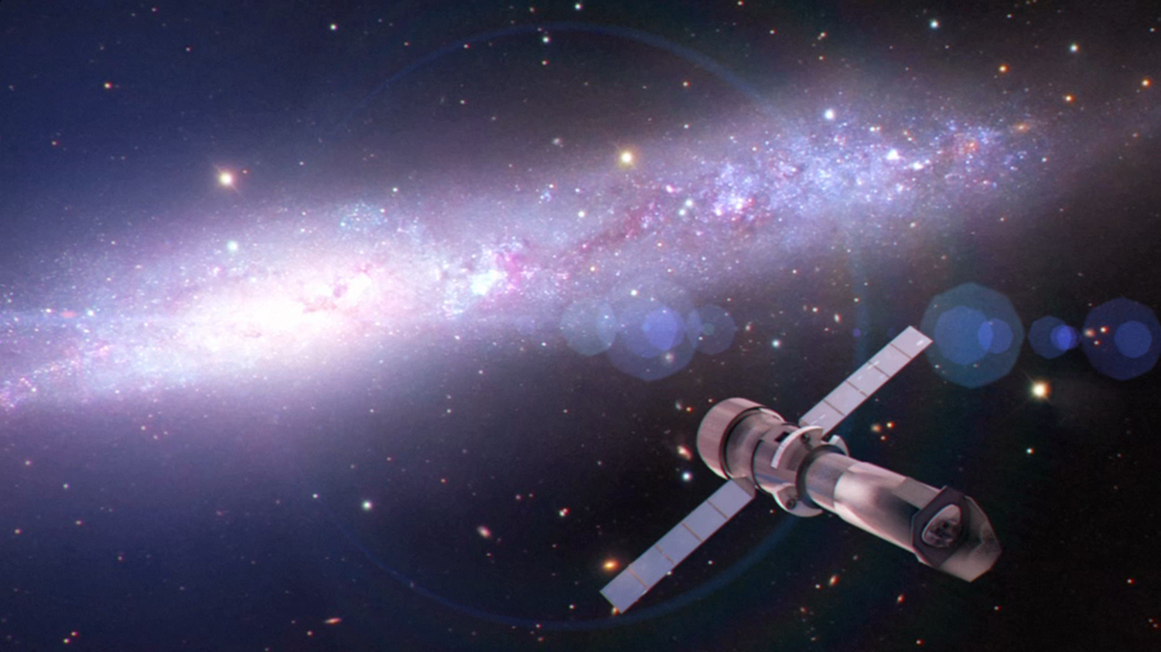
THESEUS & Athena
Paul O’Brien
(+ L. Piro, P. Yonker, K. Page, P. Evans and the Athena explosive transients team)

Slide 2
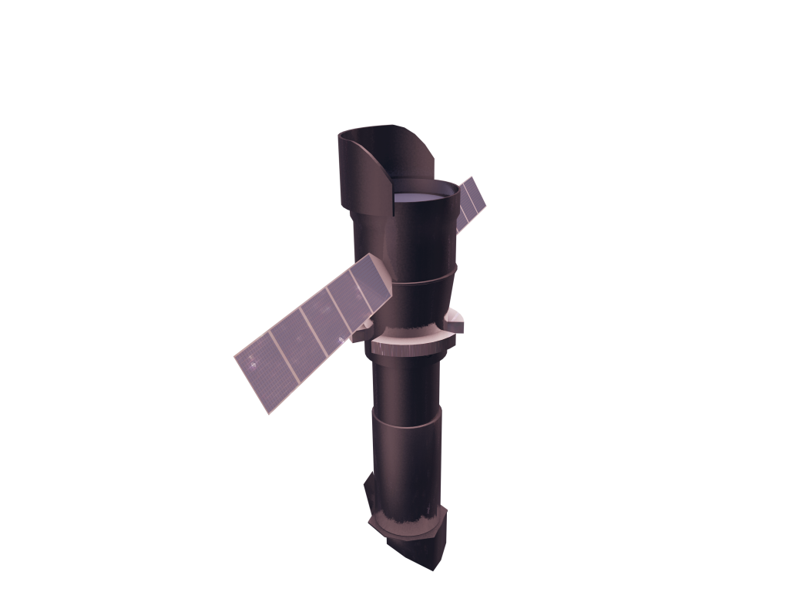
The Athena Observatory
Willingale et al, 2013 arXiv1308.6785
L2 orbit Ariane V
<5100 kg power 2500 w 5 year mission
FoR=50%
TOO in 4hrs
Silicon Pore Optics:
1.4-2 m² at 1 keV 5 arcsec HEW Focal length: 12m Sensitivity: 3 10⁻¹⁷ erg cm⁻² s⁻¹
X-ray Integral Field Unit:
ΔE: 2.5 eV Field of View: 5 arcmin Operating temp: 50 mk
Wide Field Imager:
ΔE: 125 eV Field of View: 40 arcmin High countrate capability
Barret et al., 2013 arXiv:1308.6784
Rau et al. 2013 arXiv1307.1709

Slide 3
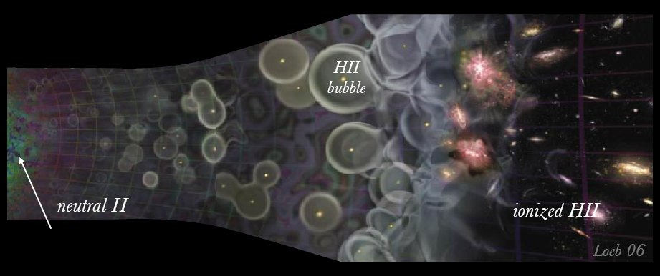
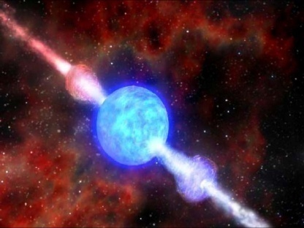
Study the first stars, the first BH, and the WHIM
z=1089
Pop III collapsars?
Pop II GRBs
z=12
z=5
z=0
Dark Ages
Reionization
Most high-z star formation takes place in galaxies beyond the reach of JWST ;
GRBs have already been found at z>8-9
Other very high z objects are not bright enough for high-res X-ray spectroscopy
GRBs also provide backlights for WHIM observations
Quasar
Galaxy
GRB
Notes:
Z= 20 circa 300Myrs
I primi

Slide 4
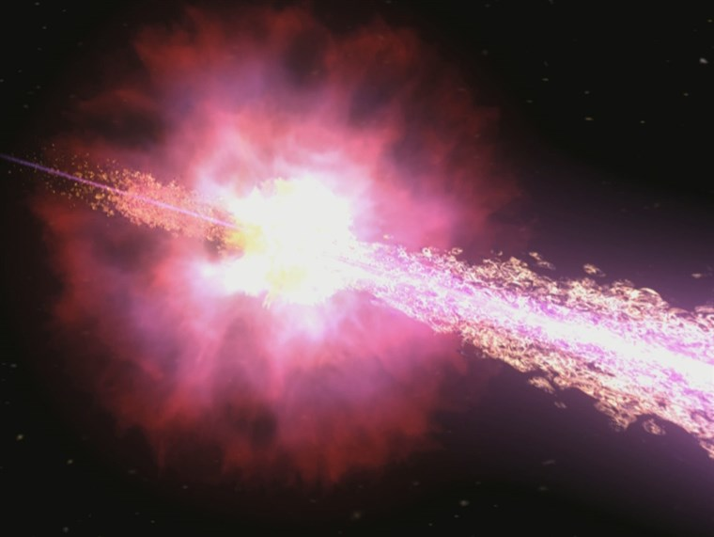
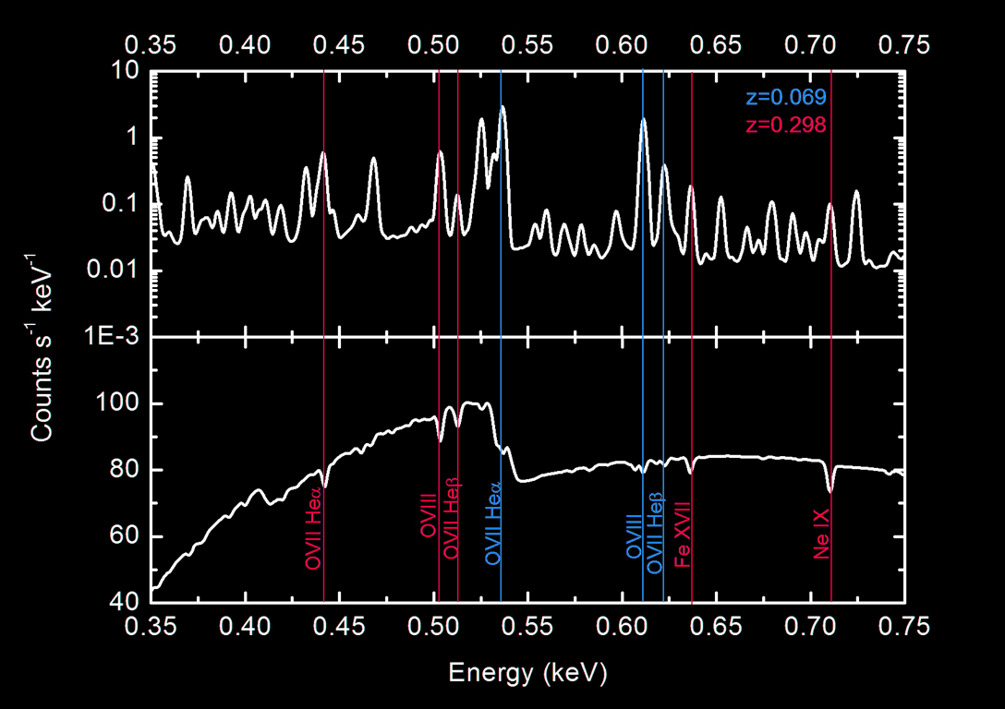
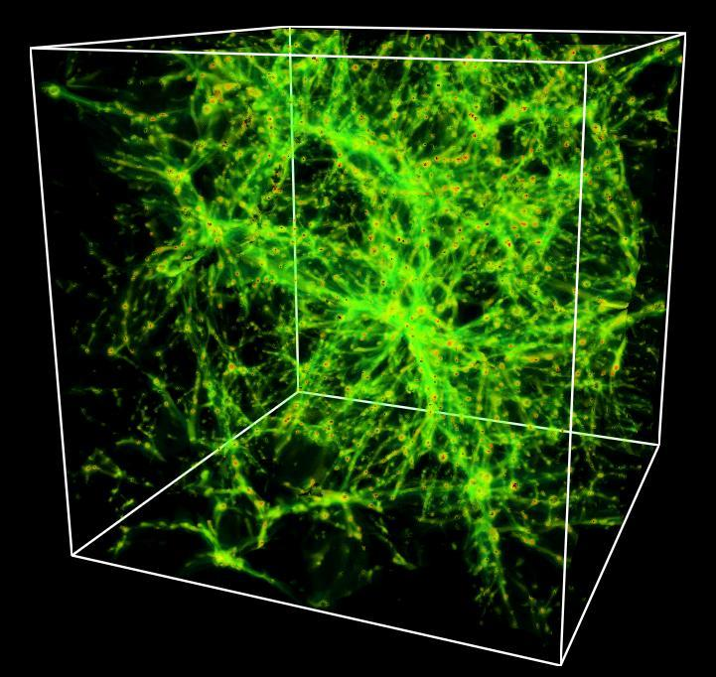
WHIM: GRB transients as probes of the large scale structures
R-SCIOBJ-141 Missing Baryons
Detect 200 WHIM filaments in absorption, 100 towards BL Lacs and 100 towards 50 bright GRB afterglows to sample the WHIM up to z=1. Determine metal abundances from emission lines in targeted regions

Slide 5
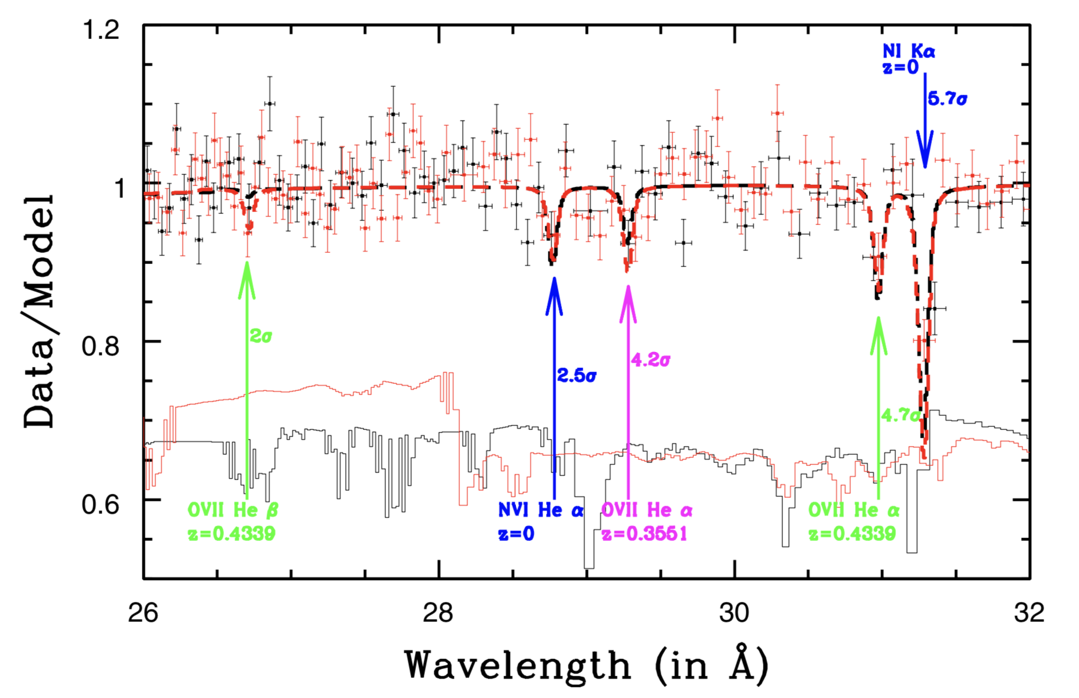
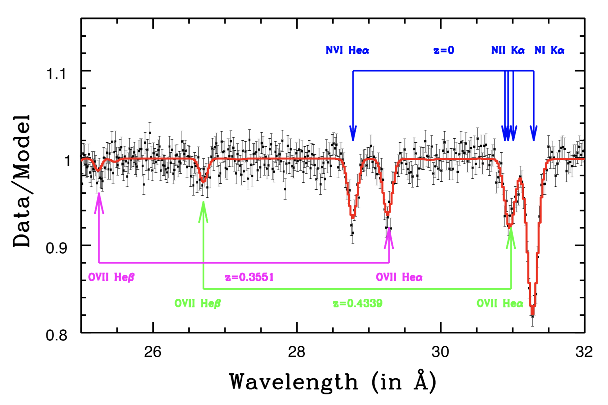
Observational evidence
1ES 1553+113, z~0.49
XMM 1.7Ms
2 filaments at z=0.35 and z=0. 43
Clustering of galaxies at z
Coincident with broad H
Athena in 160 ksec
Nicastro et al 2018, Nature

Slide 6
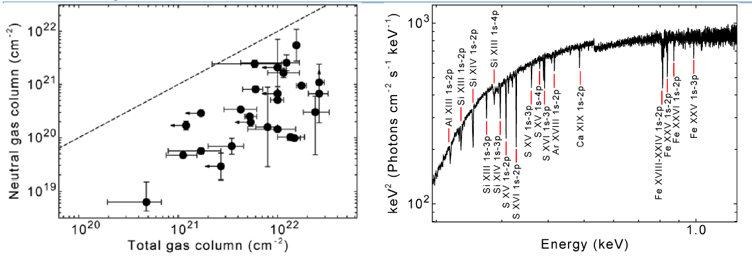
Athena R-SCIOBJ-261
Find primordial stars sites in the High-z Universe:
25 GRB afterglows with prior selection for redshift (photo-z with IR telescopes, other indicators…)
Jonker, O'Brien et al., 2013 arXiv1306.2336

Slide 7
Simulated spectrum of a bright GRB at z=7 (fluence=1x10⁻⁷ erg cm⁻², log Xi=3, Nh=6x10²¹ cm⁻²)
See lines from ions of Si, S, Fe…
(using baseline response files and XSTAR model grid)

Slide 8
Athena Level 1 Science requirements requiring rapid alerts

Slide 9
Example Athena Level 1 Science requirements requiring external transient discovery
These requirements, and several others, depend on the availability of monitor/survey instruments to feed targets (some very rapidly) to Athena for follow-up. Transient targets also includes flaring XRBs, ULXs, AGN etc.
SXI locations should be good enough for single X-IFU pointing

Slide 10
Swift sample with the Athena X-IFU
Start-end of exposure time (zero = trigger time)
40-50% have >100kcts
(For WHIM need x5-10 that value)
Phil Evans

Slide 11
THESEUS requirements
Find ~10 GRB/yr at z>7 to provide ~5/yr which are accessible to Athena (allow for field of regard and X-IFU observation)
Rapid (few hours maximum) communication of photo-z or spectro-z redshift indicator for high-z cases to trigger Athena
Good location accuracy to enable single pointing follow-up of multi-messenger targets with the WFI (<few tens of arc-minutes) and X-IFU (few arc-minutes)
Real-time, large sky area X-ray survey to find bright Galactic and extra-galactic sources in outburst for Athena follow-up
Athena requirements
Rapid response – observe within 4 hrs (goal: 2 hrs)
Pre-selected SOC/MOC procedures for high priority TOOs
Fast turn-around (communication+ground processing <1 day) to enable rapid decision on further observations

