Slide 1
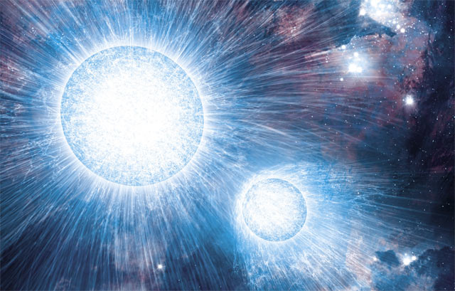
X-rays from colliding winds in massive binaries
Yaël Nazé (ULg)

Slide 2
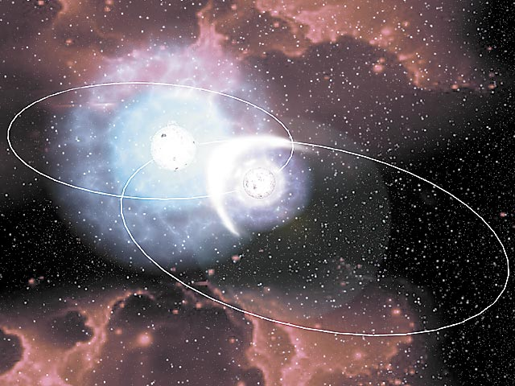
Colliding winds
Two massive stars = two supersonic winds ⇒ collision
Shocked plasma seen from radio to γ-rays
X-rays : since first obs. of massive stars (Einstein, ROSAT)…
For a full review, see Rauw & Nazé (2016, ASR, 58, 761, arxiv:1509.06480)

Slide 3
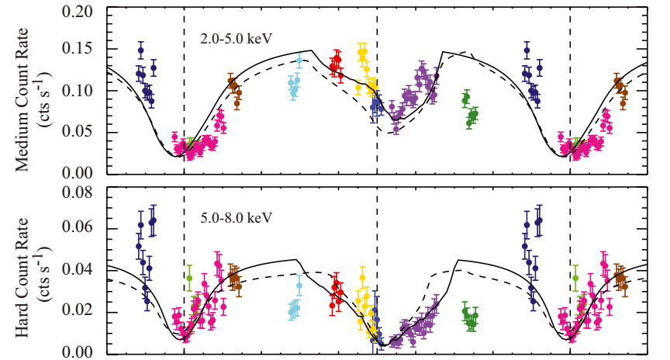
Luminosity & temperature
For O-stars : Lx ∝ 10⁻⁷ L_{BOL} (EWS, soft) + X-rays (CW, hard)
XMM & Chandra surveys ⇒ O+OB only slightly harder ⇒ strong overluminosities in O+OB not so common but usual in WR+OB
Models too bright
Eclipses are possible : e.g. in V444 Cyg
cooler
less dense
hot
dense
Oskinova 2005, Sana et al. 2006, Antokhin et al. 2008, Nazé 2009/2011, Rauw et al. 2015 - Lomax et al. 2015

Slide 4
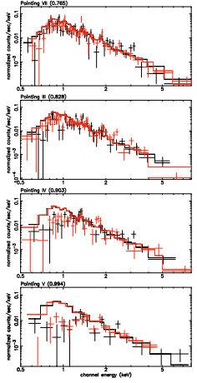
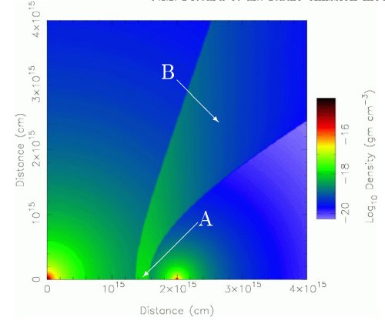
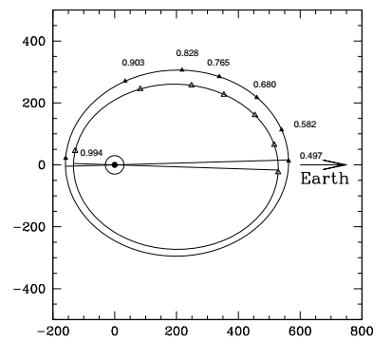
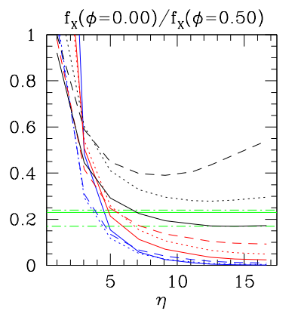
Changing absorption
Particularly spectacular in WR+OB, but also exists in O+OB
When line-of-sight in cone (γ² Vel, V444 Cyg, …)
At periastron (WR22, WR25, WR140,…)
A possibility to get wind densities (e.g. HD228766)
Collision seen through wind (prim)
Collision seen through wind (sec)
Lomax et al. 2015 , Gosset et al. 2009, Pandey et al. 2014, Corcoran et al. 2011, Rauw et al. 2014

Slide 5
Changing separation
For adiabatic collisions :
Lx ∝ 1/D, e.g. Cyg OB2 #9, 9 Sgr, WR25
1/D ?
WR140: < 1/D
WR22, γ² Vel: hard tail constant !
Nazé et al. 2012, Rauw et al. 2016, Pandey et al. 2014, Corcoran et al. 2011, Gosset et al. 2009, Rauw et al. 2000, Schild et al. 2004

Slide 6
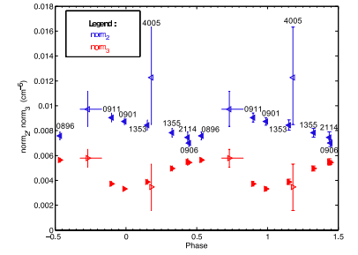
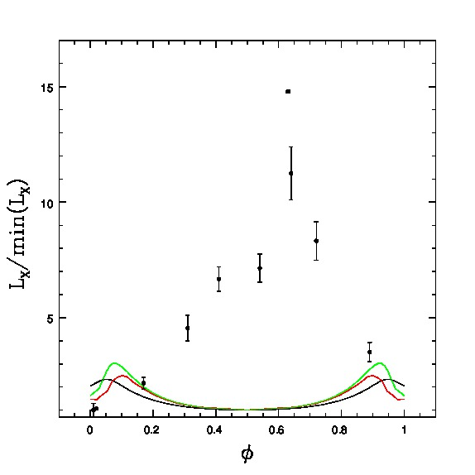
Changing separation
Faster = brighter
For radiative collisions :
Lx ∝ v², e.g. Cyg OB2 #8a
What about HD166734 ?
Slower=fainter
Cazorla et al. 2014, Nazé et al. 2017/Gosset poster

Slide 7
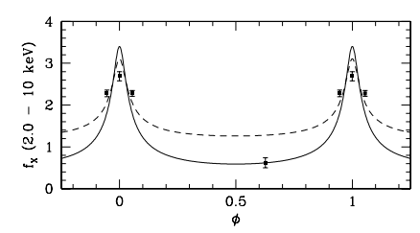
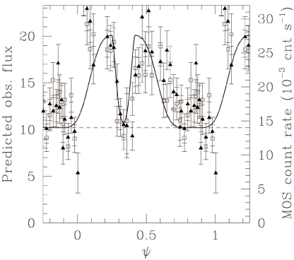
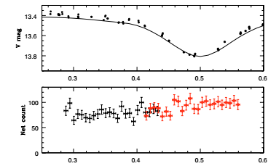
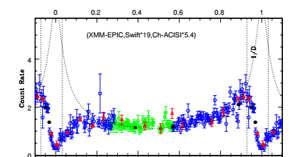
Additional effects
Radiative braking
Transition from adiab to rad @ periastron (9 Sgr, Cyg OB2 #9) : 1/D breaks
no eclipse in WR20a
Too weak secondary wind ⇒ wind crash
All the time, e.g. CPD -41 7742
Only at periastron (e.g. WR140, WR21a)
Rauw et al. 2015, Nazé et al. 2012, Nazé et al. 2008, Montes et al. 2013
Sana et al. 2005, Corcoran et al. 2011, Gosset & Nazé 2016

Slide 8
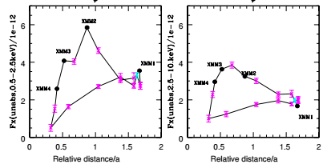
Additional effects
Orbital motion ⇒ Coriolis deflection ⇒ LC asymmetries e.g. V444 Cyg
Hysteresis
Lomax et al. 2015 , Cazorla et al. 2014, Gosset & Nazé 2016, Rauw & Nazé 2016

Slide 9
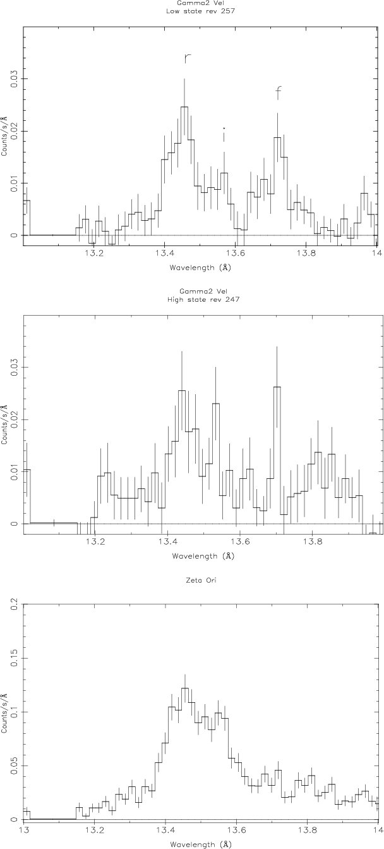
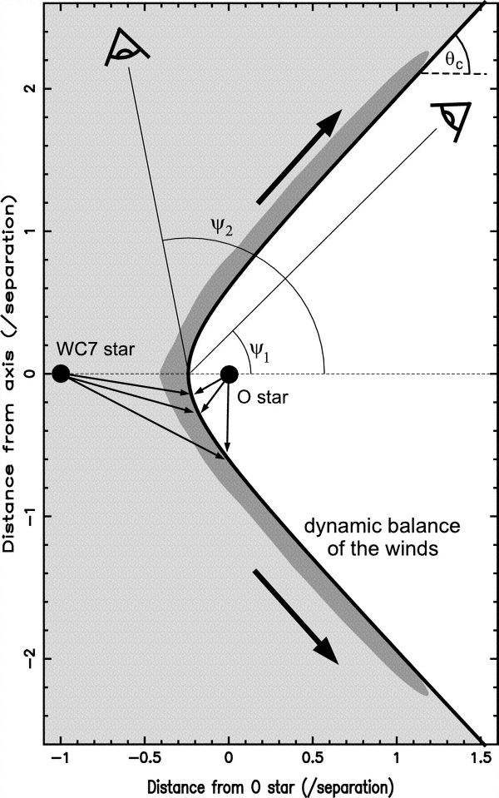
High-resolution spectroscopy
He-like triplets : f line strength = f(distance to UV src) ⇒ strong f lines in CWs (e.g. WR48a, WR140, WR147, θ Mus, γ² Vel, HD166734)
Line shift and width = f(geometry)
γ² Vel: unexpected cone geometry ⇒ rad. braking
WR140 : from blueshift to redshift
Presence of cool gas (Rad Rec Cnt, e.g. θ Mus)
Zhekov et al. 2014, Pollock et al. 2005, Zhekov & Park 2010, Sugawara et al. 2008, Schild et al. 2004, Nazé et al. 2017, Gosset poster

Slide 10
The way forward
Improving surveys: filling the parameter space
Study of extragalactic sources as winds = f(Z)
Monitoring of line profiles

